Slide 1

Knowledge Graph Creation from Text with LLMs
Ar Pazari and Didarbek Baidaliyev
Technische Universität München
TUM School of Computation, Information and Technology

Slide 2
Knowledge Graph Creation from Text with LLMs
Outline :
Introduction and Motivation
Problem Statement
Approach

Slide 3
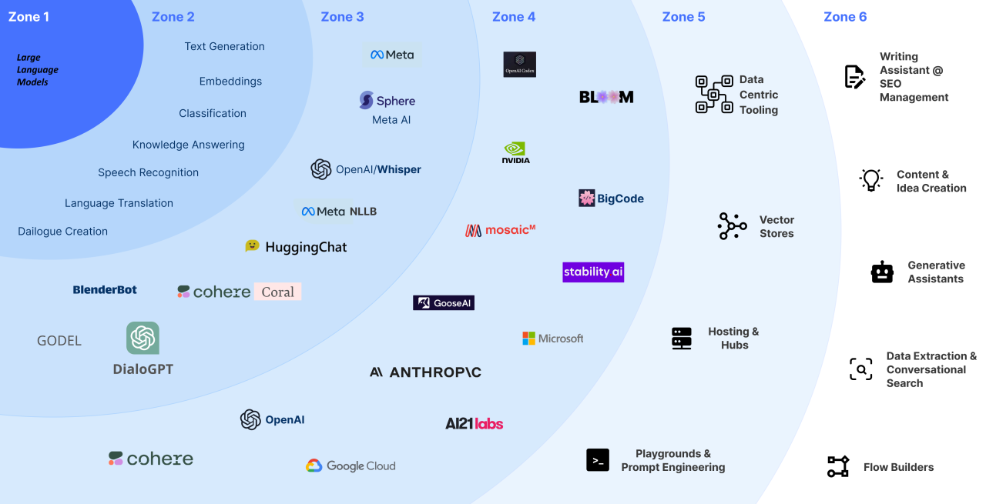
Introduction and Motivation
What are LLM’s and why are they important for us ?

Slide 4
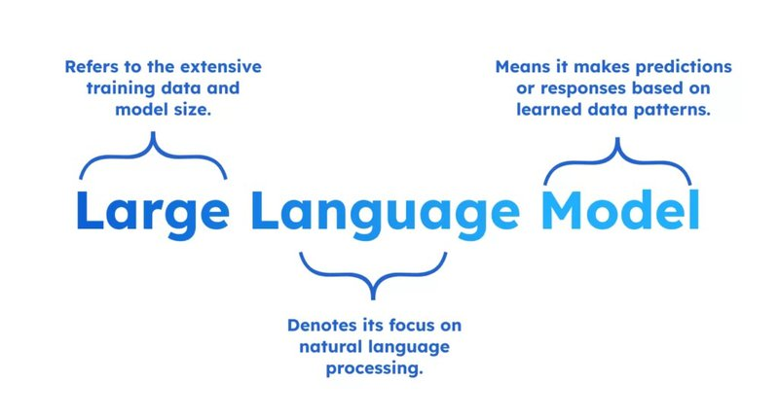
Introduction and Motivation
What are LLM’s and why are they important for us ?

Slide 5
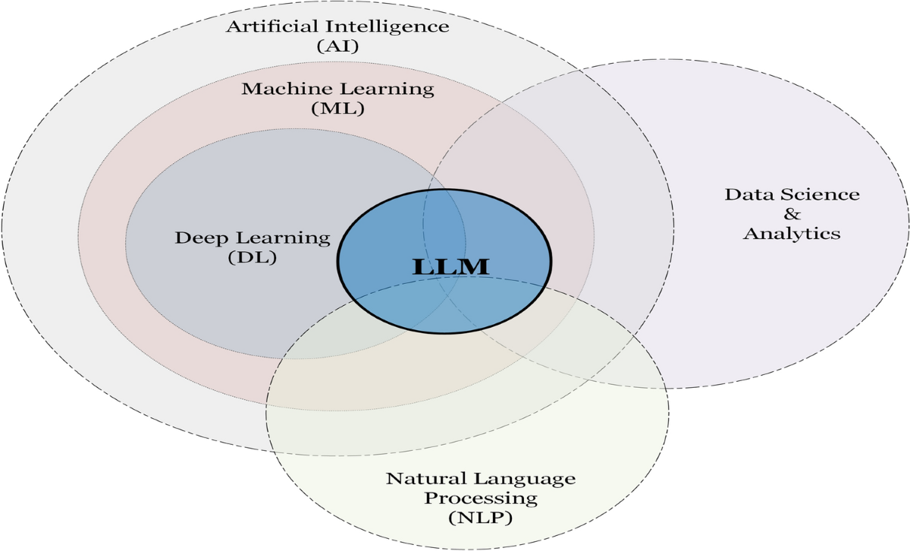
Introduction and Motivation
What are LLM’s and why are they important for us ?

Slide 6
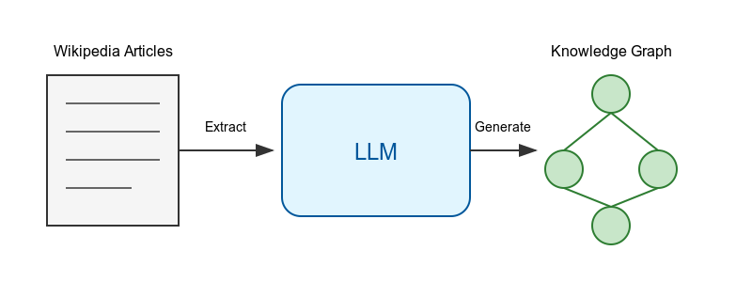
Problem statement
Transform unstructured Wikipedia articles into structured knowledge graphs using LLM’s
Key Components :
Input
Process
Output
Main Challenges :
Accuracy of Triple Extraction
Prompt Design for LLM’s
Ontology Alignment

Slide 7
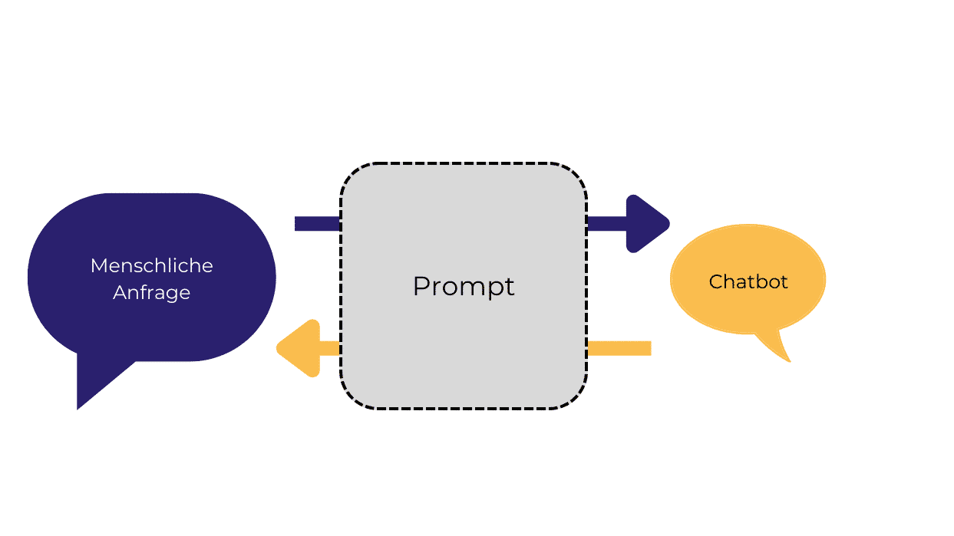
Prompt Design
What do u need Prompt Design for?

Slide 8
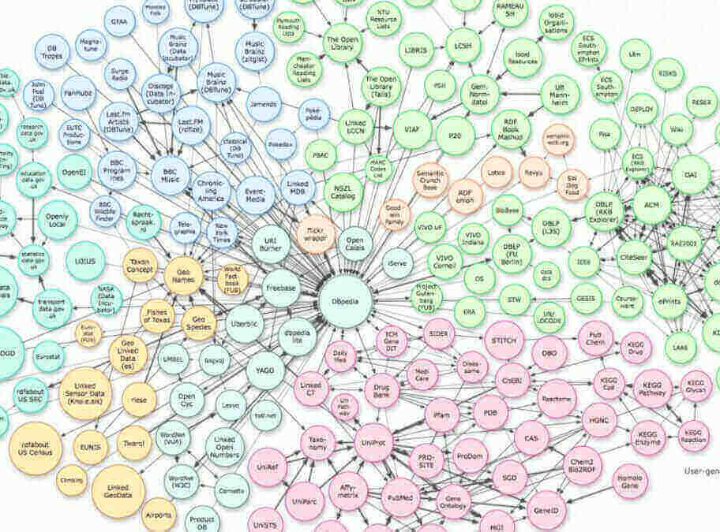
Knowledge Graphs
What are knowledge graphs and how can u represent them?

Slide 9
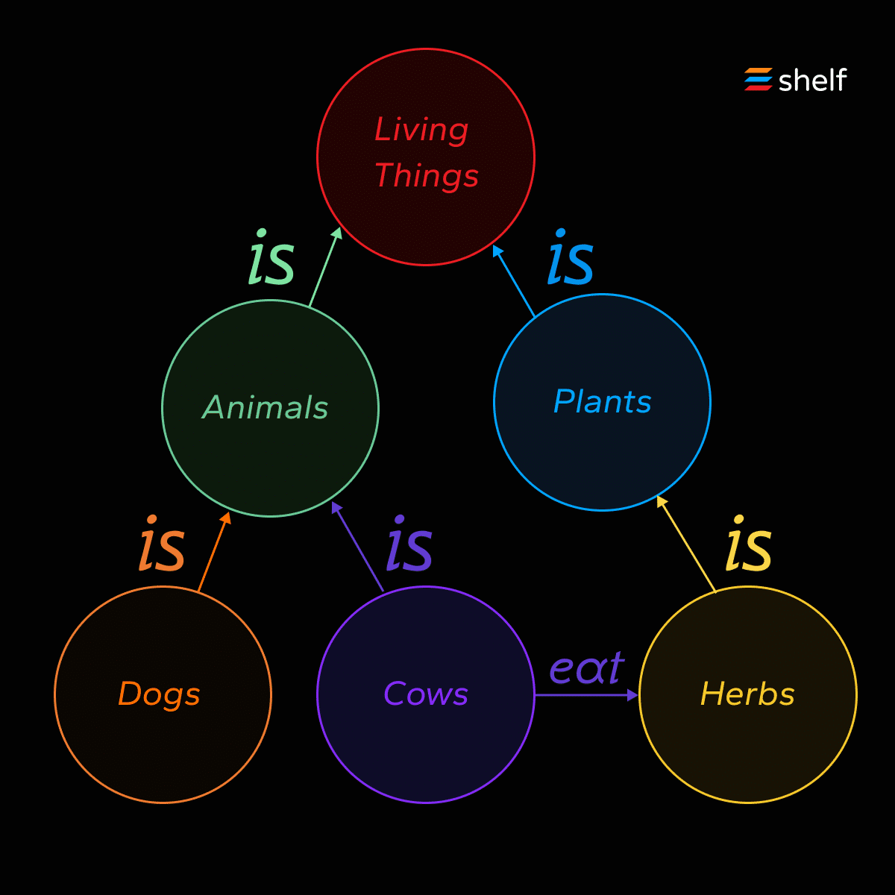
Knowledge Graphs
What are knowledge graphs and how can u represent them?

Slide 10

Ontoly Integration
What is DBpedia and how can we use it?

Slide 11
Evaluation of test results and open questions

Slide 12
V Thank you for your attention
Questions?

Slide 13
Sources
Slide number 3 - Link
Slide number 4 - Link
Slide number 5 - Link
Slide number 6 - Created using AI tools
Slide number 7 –Link
Slide number 8 - Link
Slide number 9 - Link
Slide number 10 - Link

